Slide 1
Impact of Power Grid Structure on Energy Storage Performance
Nathan Oliver

Slide 2
Project Targets
Develop new methods to optimize ES performance
ES net ability
Betweenness
Find the best location to install energy storage (ES) in the grid
Determine which grids have superior structures for ES performance
Determine grid structure factors that influence ES performance
Capacity
Impedance
Density
Number of Lines
Provide suggestions to improve future grids for ES performance

Slide 3
Why Energy Storage?
About 20% of the world’s electricity will come from solar and wind in 2040.
The issue is that generation must meet load at every instant.
Wind and solar generation is not constant and difficult to control.
If more than 20% of electricity comes from wind and solar, grid will encounter problems.
How to deal with this problem?
Energy storage (ES)
ES essentially decouples generation from load.
Power (kW)
PV Gen Profile
Load Profile
Time Shift
Time of Day
Figure 1: Time shift of electricity

Slide 4

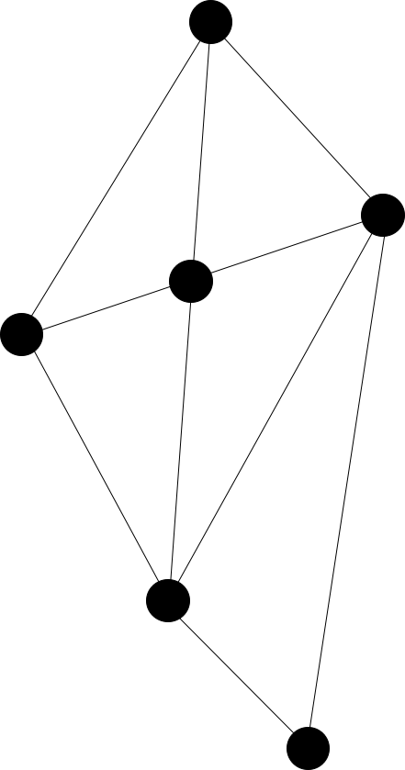
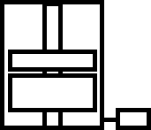
Energy Storage Considerations
Size Type Location
1 Ah
pumped-storage
5 Ah
Li-ion
10 Ah
flywheel storage
Figure 2: Comparison of size, type and location for ES considerations

Slide 5
Energy Storage Optimization
Voltage
Support
Frequency
Regulation
ES
Performance
Arbitrage
Selecting the best ES location in the grid will optimize ES performance

Slide 6
Determine Optimal ES Siting
Find the best location for ES to optimize ES performance
Centrality
Determine the most important or central nodes in a network
Several different methods to analyze centrality
Used to analyze networks in different fields of study
Biology
Transportation
Logistics
Model electrical grid as a simple network
The grid can be defined as nodes connected by lines
3
4
2
1
Figure 3: Example network

Slide 7
Pure Topological Approach
Assumptions
Lines are unweighted
One path between generator and load
This is clearly a problem
Since not all transmission lines are equal, in terms of distance or in electrical properties.
Electricity can take a multitude of paths between generator and load
In order to overcome this, the physics of power flow is considered.
A weighted model is proposed to model the physics of power flow to determine the most appropriate ES site
Z₁
Z₄
Gen
Load
Z₃
Z₂
Z₅
Figure 4: Example grid

Slide 8
Electrical Grid Considerations
Need to consider the physics of electrical grids
Need to determine path, distance, and rate of flow
Bus Type
Generator, load, or transmission bus (path)
Transmission Lines
Impedance (distance)
Electrical path
Power Transfer Distribution Factor (path and rate of flow)
Capacity
Grid cannot exceed power limit (rate of flow)
line reaches capacity limit
Trans
Z₁
Z₄
Gen
Load
Z₃
Z₂
Z₅
Trans
Figure 5: Example grid

Slide 9
Optimal ES Siting Methods
ES Net Ability Betweenness

Slide 10
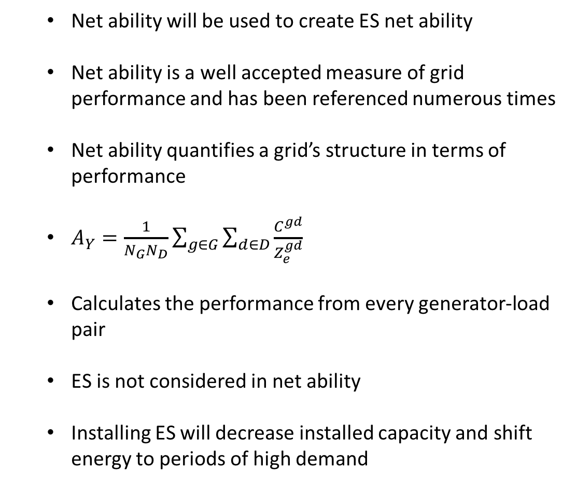
Net Ability
Net ability will be used to create ES net ability
Net ability is a well accepted measure of grid performance and has been referenced numerous times
Net ability quantifies a grid’s structure in terms of performance
$A_{Y}=\frac{1}{N_{G}N_{D}}\sum_{g∈G}{\sum_{d∈D}{\frac{C^{gd}}{Z_{e}^{gd}}}}$
Calculates the performance from every generator-load pair
ES is not considered in net ability
Installing ES will decrease installed capacity and shift energy to periods of high demand
g₂
g₁
d₁
d₂
Figure 5: Example grid with two generators and two loads

Slide 11


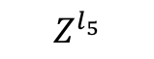
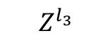
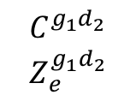
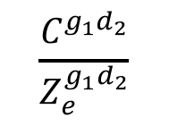
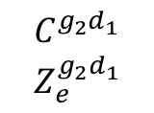
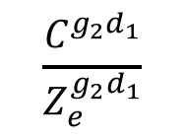
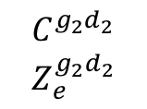
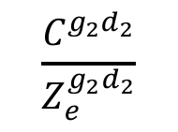
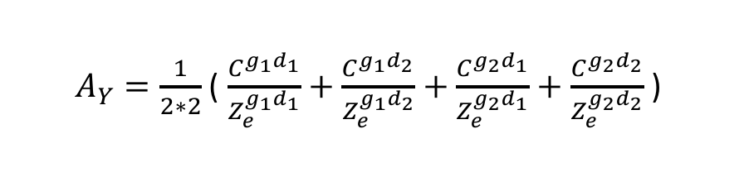
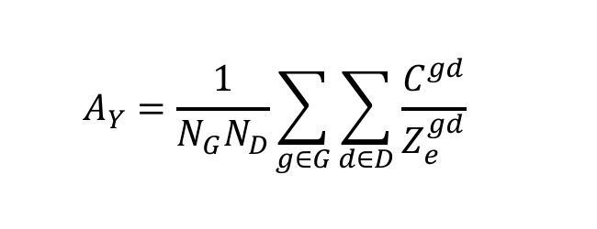
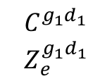
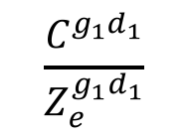
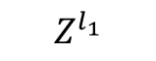
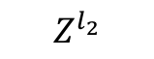
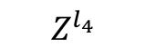
Net Ability
g₂
$$Z^{l_{1}}$$
$$Z^{l_{4}}$$
$$A_{Y}=\frac{1}{N_{G}N_{D}}\sum_{g∈G}{\sum_{d∈D}{\frac{C^{gd}}{Z_{e}^{gd}}}}$$
g₁
d₁
$$Z^{l_{3}}$$
$$Z^{l_{2}}$$
$$Z^{l_{5}}$$
d₂
g₁
d₁
g₁
d₂
g₂
d₁
g₂
d₂
$$C^{g_{1}d_{1}}$$
$$Z_{e}^{g_{1}d_{1}}$$
$$C^{g_{1}d_{2}}$$
$$Z_{e}^{g_{1}d_{2}}$$
$$C^{g_{2}d_{1}}$$
$$Z_{e}^{g_{2}d_{1}}$$
$$C^{g_{2}d_{2}}$$
$$Z_{e}^{g_{2}d_{2}}$$
$$\frac{C^{g_{1}d_{1}}}{Z_{e}^{g_{1}d_{1}}}$$
$$\frac{C^{g_{1}d_{2}}}{Z_{e}^{g_{1}d_{2}}}$$
$$\frac{C^{g_{2}d_{1}}}{Z_{e}^{g_{2}d_{1}}}$$
$$\frac{C^{g_{2}d_{2}}}{Z_{e}^{g_{2}d_{2}}}$$
$A_{Y}=\frac{1}{2∗2}$ ( $\frac{C^{g_{1}d_{1}}}{Z_{e}^{g_{1}d_{1}}}+\frac{C^{g_{1}d_{2}}}{Z_{e}^{g_{1}d_{2}}}+\frac{C^{g_{2}d_{1}}}{Z_{e}^{g_{2}d_{1}}}+\frac{C^{g_{2}d_{2}}}{Z_{e}^{g_{2}d_{2}}}$ )

Slide 12
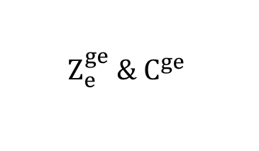
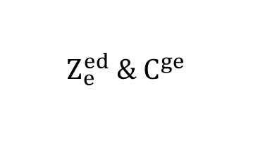
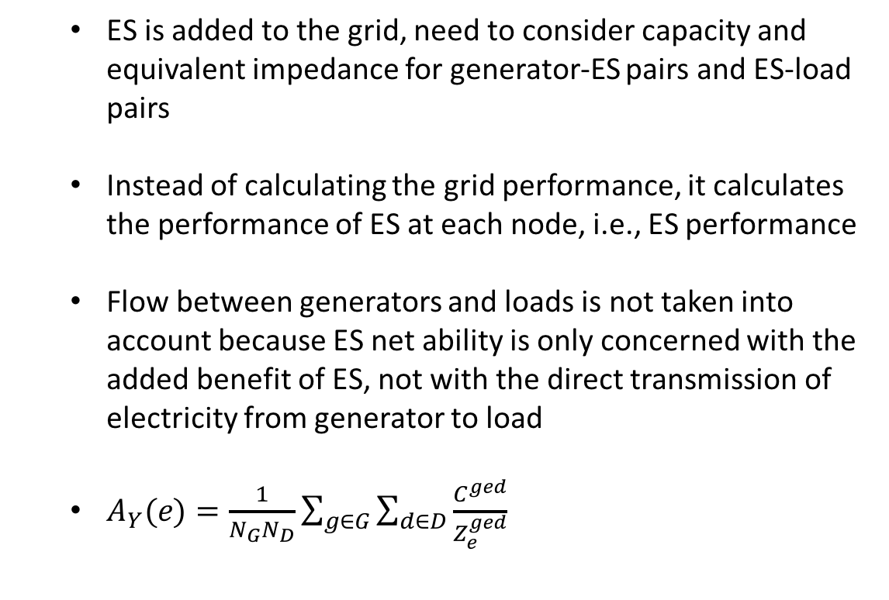
ES Net Ability
ES is added to the grid, need to consider capacity and equivalent impedance for generator-ES pairs and ES-load pairs
Instead of calculating the grid performance, it calculates the performance of ES at each node, i.e., ES performance
Flow between generators and loads is not taken into account because ES net ability is only concerned with the added benefit of ES, not with the direct transmission of electricity from generator to load
$A_{Y}(e)=\frac{1}{N_{G}N_{D}}\sum_{g∈G}{\sum_{d∈D}{\frac{C^{ged}}{Z_{e}^{ged}}}}$
e
$$Z_{e}^{ge} \& C^{ge}$$
$$Z_{e}^{ed} \&{ C}^{ge}$$
g
d
Figure 6: Grid with ES and electricity flows only through ES

Slide 13
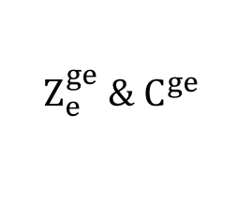
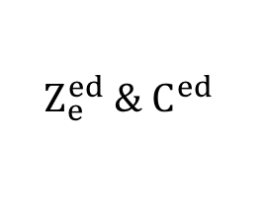
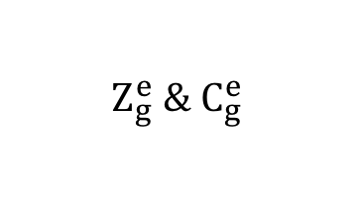
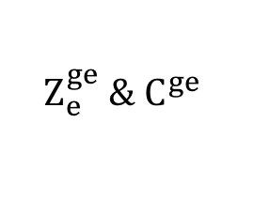
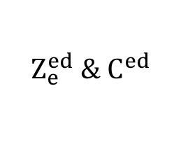
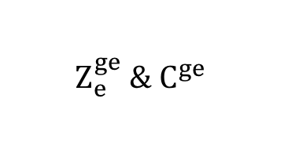
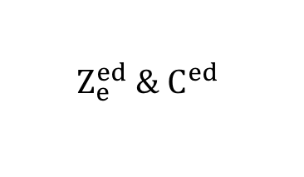
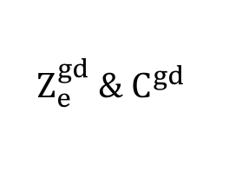
ES Net Ability
e
$$Z_{e}^{gd} \&{ C}^{gd}$$
$$Z_{e}^{ge} \&{ C}^{ge}$$
$$Z_{e}^{ed} \&{ C}^{ed}$$
g
d
g
d
Figure 7: Grid with no ES
$$Z_{g}^{e} \& C_{g}^{e}$$
Figure 8: Grid with ES and flow directly from generator to load
e
$$Z_{e}^{ge} \&{ C}^{ge}$$
$$Z_{e}^{ed} \&{ C}^{ed}$$
$$Z_{e}^{ge} \&{ C}^{ge}$$
$$Z_{e}^{ed} \&{ C}^{ed}$$
g
d
g
e
d
Figure 10: Flow between gen and load is disregarded,
only concerned with added benefit of ES
Figure 9: Flow between gen and load is disregarded,
only concerned with added benefit of ES

Slide 14
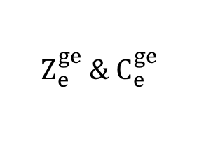
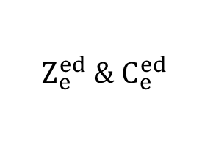
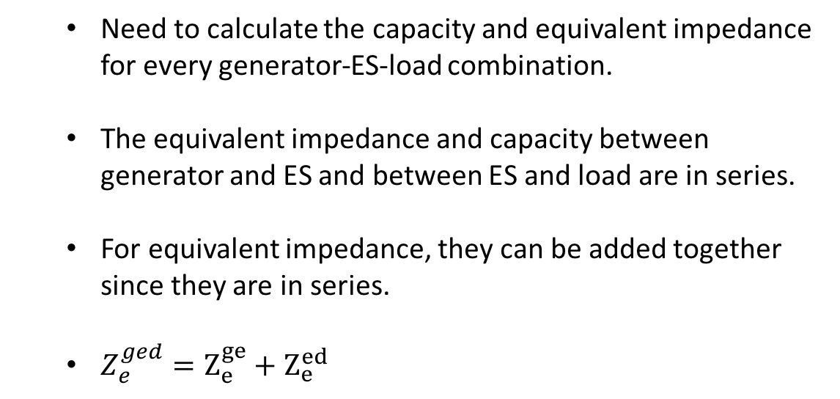
ES Net Ability
Need to calculate the capacity and equivalent impedance for every generator-ES-load combination.
The equivalent impedance and capacity between generator and ES and between ES and load are in series.
For equivalent impedance, they can be added together since they are in series.
$Z_{e}^{ged}=Z_{e}^{ge}+Z_{e}^{ed}$
$$Z_{e}^{ge} \& C_{e}^{ge}$$
$$Z_{e}^{ed} \& C_{e}^{ed}$$
g
e
d
Figure 10: Capacity and equivalent impedance can be treated as elements in series

Slide 15
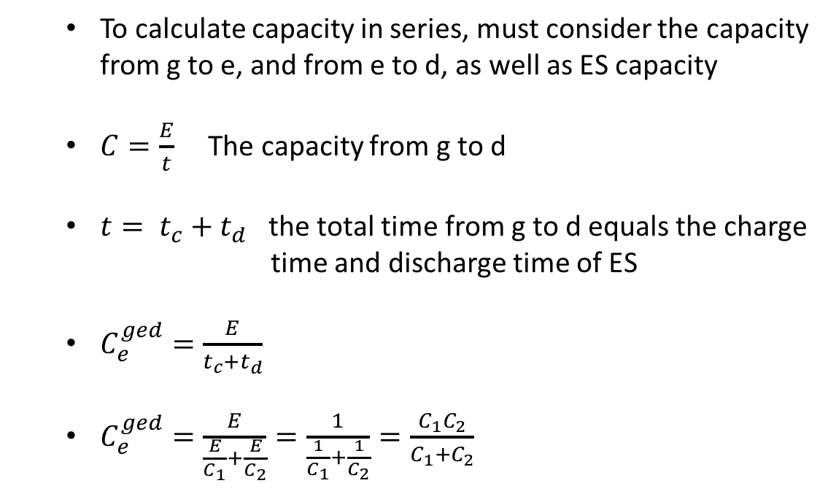
ES Net Ability
To calculate capacity in series, must consider the capacity from g to e, and from e to d, as well as ES capacity
$C=\frac{E}{t}$ The capacity from g to d
$t= t_{c}+t_{d}$ the total time from g to d equals the charge time and discharge time of ES
$C_{e}^{ged}=\frac{E}{t_{c}+t_{d}}$
$C_{e}^{ged}=\frac{E}{\frac{E}{C_{1}}+\frac{E}{C_{2}}}=\frac{1}{\frac{1}{C_{1}}+\frac{1}{C_{2}}}=\frac{C_{1}C_{2}}{C_{1}+C_{2}}$
$$Z_{e}^{ge} \& C_{e}^{ge}$$
$$Z_{e}^{ed} \& C_{e}^{ed}$$
g
e
d
Figure 11: Capacity and equivalent impedance can be treated as elements in series

Slide 16
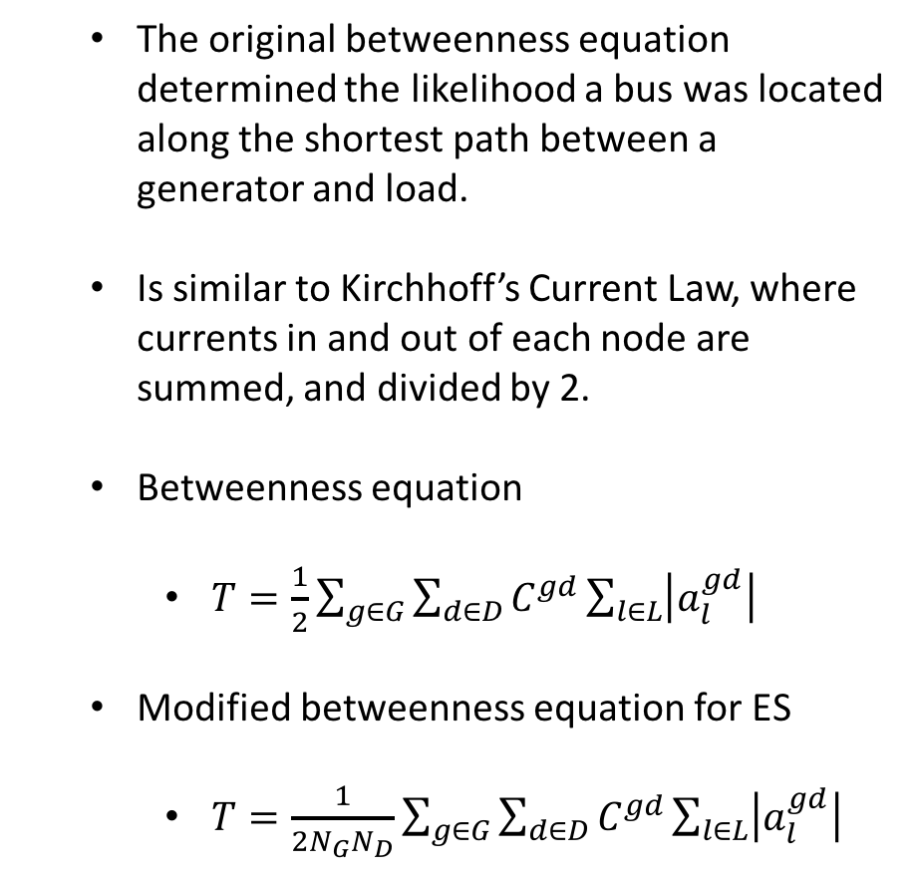

Betweenness
The original betweenness equation determined the likelihood a bus was located along the shortest path between a generator and load.
Is similar to Kirchhoff’s Current Law, where currents in and out of each node are summed, and divided by 2.
Betweenness equation
$T=\frac{1}{2}\sum_{g∈G}{\sum_{d∈D}{C^{gd}}\sum_{l∈L}{\left|a_{l}^{gd}\right|}}$
Modified betweenness equation for ES
$T=\frac{1}{2N_{G}N_{D}}\sum_{g∈G}{\sum_{d∈D}{C^{gd}}\sum_{l∈L}{\left|a_{l}^{gd}\right|}}$
2
0.6
0.8
1.0
1.0
1
4
0.2
0.4
0.2
3
Figure 12: Betweenness calculation
$$T\left(2\right)=\frac{1}{2}C^{gd}\left(0.6+0.2+0.8\right)$$
$$T\left(2\right)={0.8C}^{gd}$$

Slide 17
Case Study
Determine the optimum ES site in IEEE test systems
IEEE 30
IEEE 118
IEEE 300
Input data from IEEE test data files into a Matlab program
Program ranks each bus from best to worst for ES siting
ES net ability
Betweenness
Figure 13: IEEE 30 test system

Slide 18
Results Optimal ES Siting

Slide 19
IEEE 30 – Optimal ES Siting
ES net ability (red) – Bus 6
Betweenness (blue) – Bus 6
Figure 14: IEEE 30 test system with optimal ES site

Slide 20
IEEE 118 – Optimal ES Siting
ES net ability (red) – Bus 69
Betweenness (blue) – Bus 65
Figure 15: IEEE 118 test system with optimal ES sites

Slide 21
IEEE 300 – Optimal ES Siting
ES net ability (red) – Bus 3
Betweenness (blue) – Bus 42
Figure 16: IEEE 118 test system with optimal ES sites

Slide 22
Why?

Slide 23
Case Study
Observations
Location
Nodes in the center of the network tend to have higher ES net ability and betweenness
Number of connections
Nodes connected to more lines tend to have higher ES net ability and betweenness
The following results will only test ES net ability
Figure 17: IEEE 30 test system with optimal ES site

Slide 24
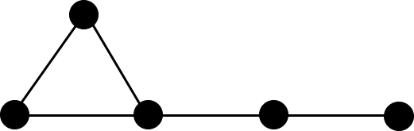
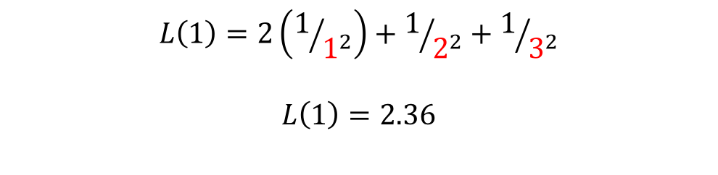
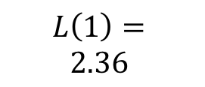
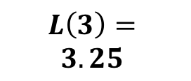
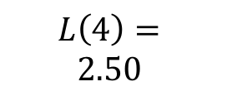
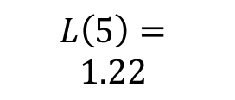
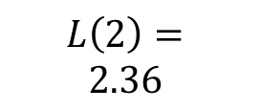
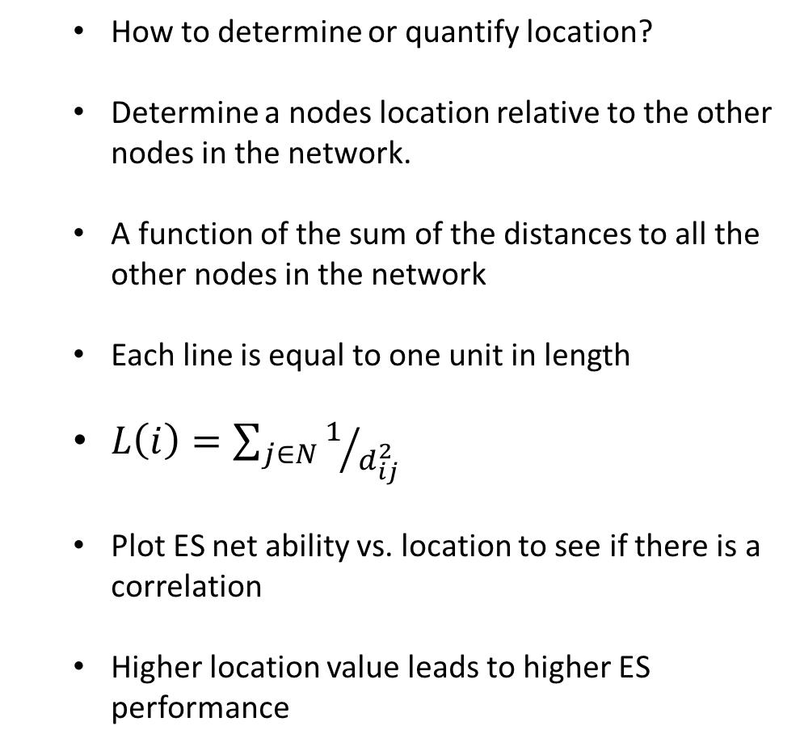
Location
How to determine or quantify location?
Determine a nodes location relative to the other nodes in the network.
A function of the sum of the distances to all the other nodes in the network
Each line is equal to one unit in length
$L\left(i\right)=\sum_{j∈N}{1/{d_{ij}^{2}}}$
Plot ES net ability vs. location to see if there is a correlation
Higher location value leads to higher ES performance
2
$$L\left(2\right)=$$
$$2.36$$
1
3
4
5
1
$$L\left(1\right)=$$
$$2.36$$
$$L\left(3\right)=$$
$$3.25$$
$$L\left(4\right)=$$
$$2.50$$
$$L\left(5\right)=$$
$$1.22$$
1
2
3
$$L\left(1\right)=2\left(1/{1^{2}}\right)+1/{2^{2}}+1/{3^{2}}$$
$$L\left(1\right)=2.36$$

Slide 25
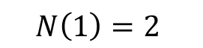
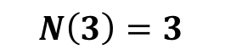
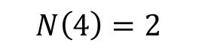
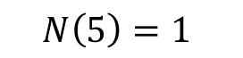
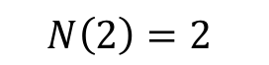
Number of Connections
Sum the number of lines connected to each node
Plot ES net Ability vs. number of connections to see if there is a correlation
More connections leads to higher ES performance
2
$$N\left(2\right)=2$$
3
4
5
1
$$N\left(1\right)=2$$
$$N\left(3\right)=3$$
$$N\left(4\right)=2$$
$$N\left(5\right)=1$$

Slide 26
Results Factors of Optimal ES Siting

Slide 27
IEEE 30, 118, 300 - Location
Figure 18: IEEE 30 – ES net ability vs. node location
Figure 19: IEEE 118 – ES net ability vs. node location
Figure 20: IEEE 300 – ES net ability vs. node location

Slide 28
IEEE 30, 118, 300 - Number of Connections
Figure 21: IEEE 30 – ES net ability vs. connections
Figure 22: IEEE 118 – ES net ability vs. connections
Figure 23: IEEE 300 – ES net ability vs. connections

Slide 29
Location vs. Number of Connections
For all seven test systems, location had a higher R² than number of connections
Node location is a much stronger factor for a nodes ES net ability than number of connections
Bus System | Coefficient of Determination (R²)
 | Node Location | Number of Connections
IEEE 14 | 0.85 | 0.81
IEEE 30 | 0.88 | 0.77
IEEE 33 | 0.47 | 0.42
New England 39 | 0.87 | 0.71
IEEE 57 | 0.89 | 0.74
IEEE 118 | 0.82 | 0.61
IEEE 300 | 0.70 | 0.40
Figure 24: IEEE 118 – ES net ability vs. node location
Figure 25: IEEE 118 – ES net ability vs. connections

Slide 30
What Makes a Grid’s Structure Better for ES Performance?

Slide 31
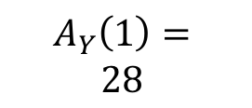
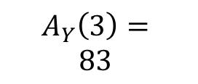
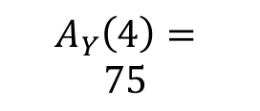




Case Study
How to determine or quantify a grids structure?
Take the average ES net ability of all the nodes in a network.
$G_{A}=\frac{1}{n_{t}}\sum_{n∈N}{A_{Y}}$
This is called grid ES net ability
Compare grid ES net ability to…
Other grid ES net ability (which grid is better)
Impedance
Capacity
Lines per Node (Number of Connections)
Density (Location)
2
$$A_{Y}\left(2\right)=28$$
3
4
5
1
$$A_{Y}\left(1\right)=$$
$$28$$
$$A_{Y}\left(3\right)=$$
$$83$$
$$A_{Y}\left(4\right)=$$
$$75$$
$$A_{Y}\left(5\right)=25$$
$$G_{A}=\frac{1}{5}(28+28+83+75+25)$$
$$G_{A}=48$$

Slide 32
Results Grid Structure

Slide 33
Grid Structure - Capacity
Line capacities were changed and then grid ES net ability was measured
Results show capacity and grid ES net ability are directly related
Higher line capacity leads to better ES performance
Figure 26: IEEE 30 – Grid ES net ability vs. line capacity

Slide 34
Grid Structure - Impedance
Line impedances were changed and then grid ES net ability was measured
Results show impedance and grid ES net ability are inversely related
Lower line impedance leads to better ES performance
Figure 27: IEEE 30 – Grid ES net ability vs. line impedance

Slide 35
Grid Structure - Lines per Node
Grid ES net ability of seven different grids was plotted against its lines per node
Results show that possibly having more lines with fewer nodes in a grid will lead to higher ES performance
More data needs to be collected to verify this claim
Figure 27: IEEE 30 – Grid ES net ability vs. lines per node

Slide 36


Grid Structure - Density
Density of a grid is a function of the distance to other nodes in the network
$L\left(i\right)=\sum_{j∈N}{1/{d_{ij}^{2}}}$
Results showed no correlation between average location (density) and grid ES net ability
Further research will need to be performed to verify whether density leads to higher ES performance
Figure 28: Grid with low density
Figure 29: Grid with high density

Slide 37
Conclusion
Novel method to determine optimal ES siting
Location of a node is a strong determinant of its ES performance. More centrally located nodes will have better ES performance.
Can determine which grids have superior structure for ES performance
Several factors determine a grids overall ES performance
Impedance
Lower impedance leads to higher ES performance
Capacity
Higher capacity leads to higher ES performance
Lines per Node
More lines may lead to higher ES performance
Density
Relationship unclear. More research is needed.

Slide 38
Thank You Any Questions?

